Slide 1
OPTIMAL LOCATION FOR RESTAURANT IN LONDON
CAPSTONE PROJECT WEEK 2

Slide 2
Introduction
London being a large city is full of many different people of different ethinicities with different tastes and thus this leads to several restaurants that cater for the different needs of the people.
London is populated by several restaurants each sering different and unique cuisines
This project is aimed at helping entrepreneurs who are aiming at starting up their own restaurants for business within the city.
It is aimed at helping them find the appropriate location to set up shop with respect to the typeof restaurant they plan on introducing.

Slide 3
DATA ACQUISITION AND CLEANING
The source of the data was from the foursquare app.
The coordinates of London were used to establish a certain radius from the city centre.
Within this radius, I identified the restaurants in the area
The restaurants were clustered into groups based on their similarities, each group different from the other based on several differences such as the cuisines, or just the food they serve.

Slide 4
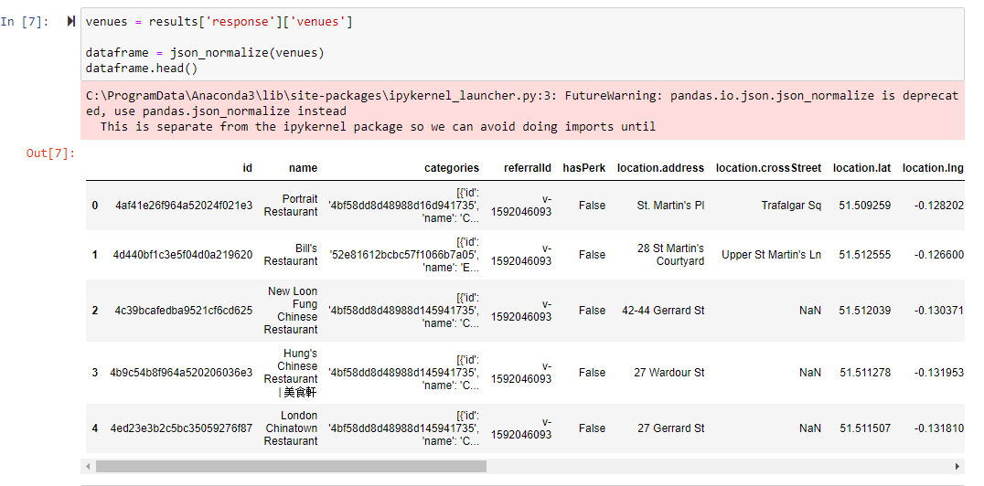
DATA ACQUISITION AND CLEANING

Slide 5
DATA ANALYSIS
The data I used in this project came from one source and thus was simple enough to analyse.
The restaurants were subdivided into groups based on the cuisines or other general factors.

Slide 6
CUISINES
The restaurants that were divided in terms of the cuisines they serve were quite a few.
They included the Italian cuisine, Indian cuisine, Chinese cuisine among others.
London still has room for more types of cuisines.

Slide 7
OTHER CATEGORIES
The other categories that arent based on cuisines are divided based on the types of food or services they provide.
This is seen in cases where the restaurants are categorised in cases such as the sea food restaurants and the eine bar restaurants.

Slide 8
PREDICTIVE MODELS
The locations of the restaurants being recorded were categorised into clusters and then plotted on a Map showing each group individually on different maps.
This maps were used to identify the areas that weren't already populated by restaurants.

Slide 9
CONCLUSION
This project was aimed at giving the best location for setting up restaurants in the city of London.
Based on our results, the maps give us an average of the areas that are available and are potential sites to set up shop.

